Slide 1

Enterprise Software Development

Slide 2

WHAT’S NEW IN ASP.NET MVC 6
@Adamstephensen | Solution Architect @ SSW

Slide 3

Goodbye ApiController

Slide 4
WebAPI and Controllers in one
public class ValuesController : Controller { // GET /values public string Get() { return "Values"; } // GET /values/1 public string Get(int id) { return "Value " + id.ToString(); } // POST /values public ActionResult Post() { return new HttpStatusCodeResult(201); } }
http://rules.ssw.com.au/SoftwareDevelopment/RulesToBetterWebAPI/Pages/Default.aspx

Slide 5
Razor Tag Helpers

Slide 6
14. Razor Tag Helpers
Old
@Html.ActionLink(“Click me”, “View”, “Controller”)
New
<a asp-controller=“Controller” asp-view=“Index”>Click me</a>

Slide 7
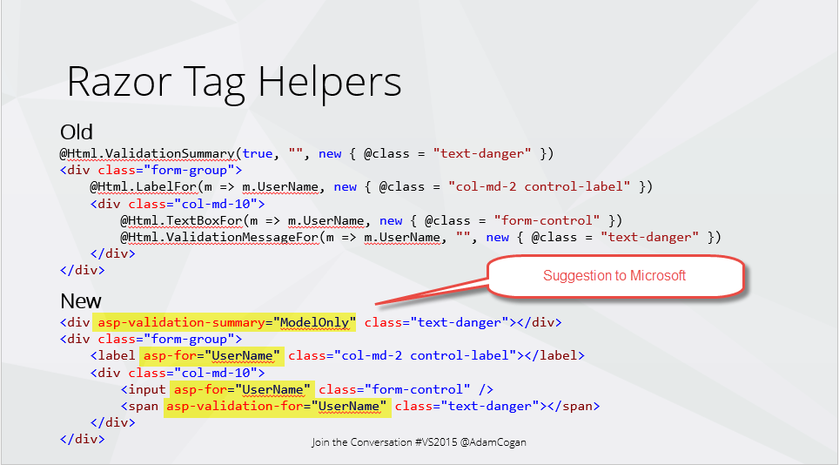
Razor Tag Helpers
Old
@Html.ValidationSummary(true, "", new { @class = "text-danger" })
<div class="form-group">
@Html.LabelFor(m => m.UserName, new { @class = "col-md-2 control-label" })
<div class="col-md-10">
@Html.TextBoxFor(m => m.UserName, new { @class = "form-control" })
@Html.ValidationMessageFor(m => m.UserName, "", new { @class = "text-danger" })
</div>
</div>
New
<div asp-validation-summary="ModelOnly" class="text-danger"></div>
<div class="form-group">
<label asp-for="UserName" class="col-md-2 control-label"></label>
<div class="col-md-10">
<input asp-for="UserName" class="form-control" />
<span asp-validation-for="UserName" class="text-danger"></span>
</div>
</div>

Slide 8
Razor Tag Helpers
More HTML like
More readable
More control over how the HTML outputs
Harder to tell server side code from client side code

Slide 9
View components

Slide 10
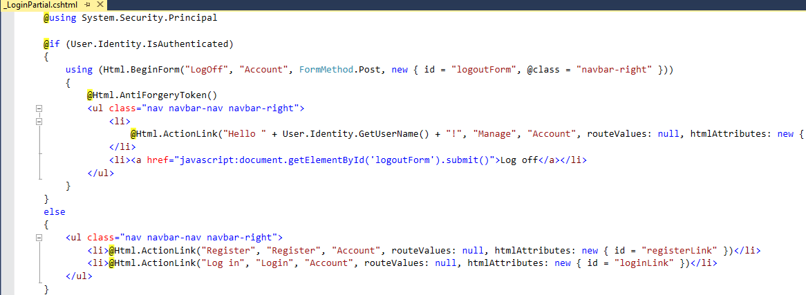
MVC – Partials… the problems
Could get messy with if statements blocks mixed with html
How can I test?

Slide 11
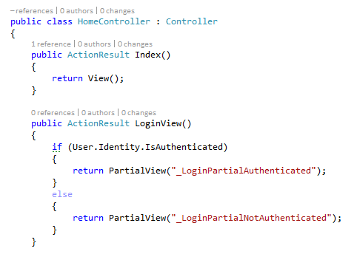
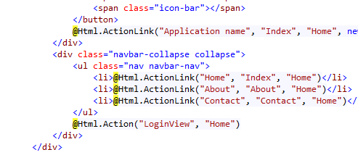
The fix… put the logic in a controller
Create an action on the controller that has the logic
Render the action on the page
Fixes the problem but…
Partials now combined with controllers
Make controllers fat
Component is not completely separate

Slide 12
Or use… New - View Components
Similar to partial views, but more powerful.
Includes the same separation-of-concerns + testability found between a controller and view.
Like a mini-controller—responsible for rendering a chunk rather than a whole response.
Can solve any problem that is too complex or messy with a partial, such as:
Login panel
Dynamic navigation menus
Tag cloud (where it queries the database)
Shopping cart

Slide 13
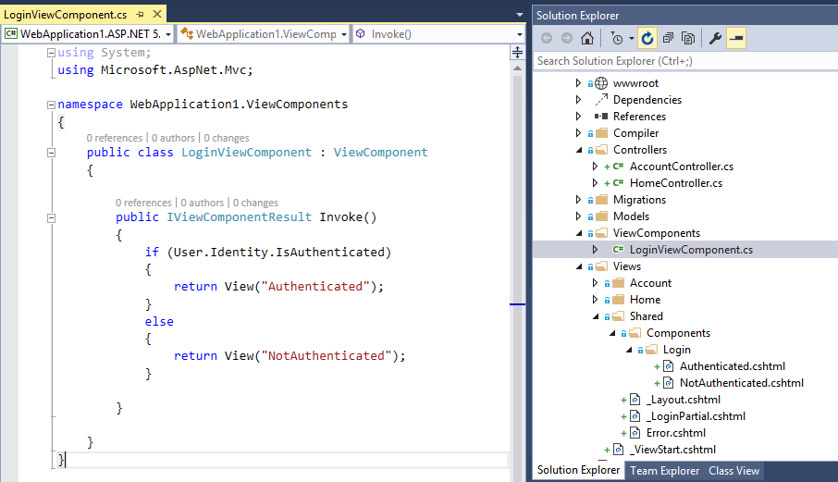

Logic in the component can be unit tested. Views separated from logic

